Slide 1
Day 2
DML Statements
Insert Update Delete
Transactions

Slide 2
RECAP

Slide 3
Agenda
Describe each data manipulation language (DML) statement
Insert rows into a table
Update rows in a table
Delete rows from a table
Control transactions

Slide 4
INSERT Statement Syntax
INSERT INTO table [(column [, column…])]
VALUES (value [, value…]);
Inserts only one record.
INSERT
INTO table [(column [, column…])]
SELECT column1, column2 … column n from table2

Slide 5
example
INSERT INTO tbl_books (book_id, author, title, genre_id, amount)
VALUES (1, 'Twain, Mark', 'Tom Sawyer', 1, 20.00);
INSERT INTO tbl_books (book_id, author, title, genre_id, amount)
VALUES (2, 'Shakespeare', 'Hamlet, Prince of Denmark', 2, 5.00);
INSERT INTO tbl_books (book_id, author, title, genre_id, amount)
VALUES (3, 'Tolkien, J.R.', 'Lord of the Rings', 2, 31.00);
-- see data within our table
SELECT * FROM tbl_books ;

Slide 6
Copying Rows from Another Table
Write the INSERT statement with a subquery:
-- prepare create another table
create table tbl_Old_Books as SELECT * FROM tbl_books;
INSERT INTO tbl_Old_Books (book_id, book_code, author, title, genre_id, amount)
SELECT book_id, book_code, author, title, genre_id, amount FROM tbl_books WHERE book_id = 1 ;
Do not use the VALUES clause
The number of columns in the INSERT clause match to those in the subquery

Slide 7
UPDATE Statement Syntax
UPDATE table
SET column = value [, column = value, …]
[WHERE condition];
Update more than one row at a time (if required)

Slide 8
examples
UPDATE tbl_books SET amount = 50
WHERE book_id = 1;
1 row updated
UPDATE tbl_books SET amount = 41
WHERE author = 'Twain, Mark’;
2 rows updated
All rows are updated if the WHERE clause is omitted

Slide 9
Updating columns with subqueries
UPDATE tbl_books
SET author = (SELECT author
FROM tbl_books
WHERE book_id = 4)
WHERE book_id = 1;

Slide 10
Delete statement
DELETE [FROM] table
[WHERE condition];

Slide 11
examples
DELETE FROM tbl_books
WHERE book_id = 4;
1 record deleted
DELETE FROM tbl_books WHERE genre_id = 1;
2 records deleted
DELETE FROM tbl_books;
All rows are deleted if the WHERE clause is omitted

Slide 12
Database transactions
A database transaction is a unit of work that consists of one of the following:
One or more DML statements
Transaction ends on COMMIT or ROLLBACK or some DDLs (ie TRUNCATE)
Takes place over a (user) session
A transaction provide an “all-or-nothing” proposition, meaning that all the actions within a transaction should either fail or succeed together.
Connection represents connection to the server over a network or locally through shared memory
A session represents a user process

Slide 13
Deleting rows based on another table
Use subquery to remove rows from a table based on values from another table.
DELETE FROM tbl_books
WHERE genre_id = (SELECT genre_id FROM tbl_genres WHERE name = 'Adventure’);
3 rows deleted

Slide 14
Database transactions (continued)
Begin when the first DML SQL statement is executed
End with one of the following events:
A COMMIT or ROLLBACK statement is issued.
On some DDL executes (ie TRUNCATE TABLE ).
Tool level Autocommit setting (DBVisualizer)
The system crashes.

Slide 15
Transaction control language
TCL statements provide the functionality to save or undo the changes made with DML statements.
COMMIT saves changes to the database since the session began, or since
the most recent commit event in the session, whichever is more recent.
ROLLBACK undoes changes to the database back to the last “commit” point in the session.

Slide 16
Controlling transactions
Transaction 1
Transaction 2
BEGIN;
BEGIN;
INSERT…
INSERT…
UPDATE…
UPDATE…
INSERT…
INSERT…
END; or COMMIT;
ROLLBACK;
COMMIT SCENARIO
ROLLBACK SCENARIO
16

Slide 17
Example transaction with commit
Transaction 1 script
set search_path = sandbox_data ;
begin ;
drop table if exists tbl_genres1 ;
CREATE TABLE tbl_genres1 (
genre_id int not null ,
name character varying(10) not null ,
description character varying(200) not null
, CONSTRAINT pk_tbl_genres1 PRIMARY KEY (genre_id)
) ;
insert into tbl_genres1 (genre_id, name, description) values (1,'Adventure','just Adventure’)
commit ;
-- TRY this on a different session
set search_path = sandbox_data ;
select * from tbl_genres1 ;
select * from public.tbl_genres1 ;

Slide 18
Example transaction with ROLLBACK
Transaction 1 script
set search_path = sandbox_data ;
begin ;
drop table if exists tbl_genres1 ;
CREATE TABLE tbl_genres1 (
genre_id int not null ,
name character varying(10) not null ,
description character varying(200) not null
, CONSTRAINT pk_tbl_genres1 PRIMARY KEY (genre_id)
) ;
insert into tbl_genres1 (genre_id, name, description) values (1,'Adventure','just Adventure’)
rollback ;
-- TRY this on a different session
set search_path = sandbox_data ;
select * from tbl_genres1 ;
select * from public.tbl_genres1 ;

Slide 19
implicit transaction processing
An automatic commit (Redshift) occurs under the following circumstances:
DCL statement is issued, Commit (End) or Rollback
Normal exit from DBVis when connection was set autocommit=on
An automatic rollback occurs under an abnormal termination of DBVisualizer or a system failure

Slide 20
State of the data before commit or rollback
The current user can review the results of the DML operations by using the SELECT statement
Other users cannot view the results of the DML statements by the current user
The affected rows are locked; other users cannot change the data in the affected rows.

Slide 21
State of the data after commit
Data changes are made permanent in the database
The previous state of the data is permanently lost
All users can view the results
Locks on the affected rows are released; those rows are available for other users to manipulate

Slide 22
State of the data after rollback
Discard all pending changes by using the ROLLBACK statement:
Data changes are undone
Previous state of the data is restored
Locks on the affected rows are released

Slide 23
Summary RECAP DML
Function | Description
INSERT | Adds a new row to the table
UPDATE | Modifies existing rows in the table
DELETE | Removes existing rows from the table
COMMIT | Makes all pending changes permanent
ROLLBACK | Discards all pending data changes

Slide 24
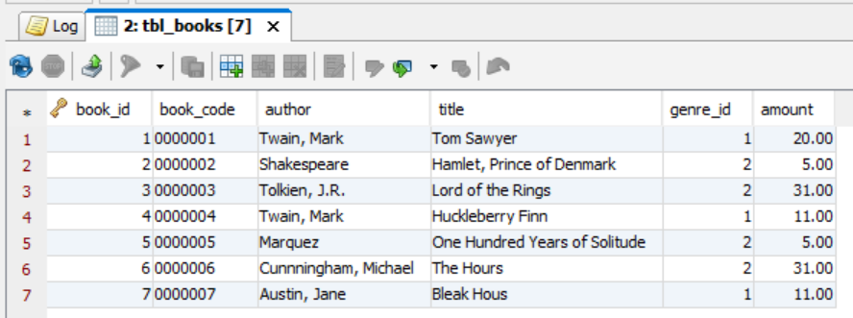
OUR DEMO TABLE

Slide 25
SQL query , WRITING A SELECT
basic form SQL SELECT statement has SELECT, FROM clauses
SELECT *
SELECT column1, column2 FROM table
Filter result set use the WHERE clause
SELECT column1, column2 FROM table WHERE column1='value'
Exercise
select genre_id, name from sandbox_data.tbl_genres1 ;
select genre_id, name from sandbox_data.tbl_genres1 where genre_id = 1;

Slide 26
SELECT ORDER BY
Order an Select result set
SELECT column1, column2 FROM table
ORDER BY column3 ASC, column4 DESC
Example
select * from tbl_books order by genre_id desc;

Slide 27
SELECT TOP / LIMIT
Limit an Select result set
SELECT *FROM table
LIMIT n;
Example
select * from tbl_books limit 2 ;

Slide 28
SELECT DISTINCT
Return only Distinct values select result set
SELECT DISTINCT column1 [, column2 … ] FROM table
Example
select distinct genre_id from tbl_books order by 1;

Slide 29
SELECT BETWEEN
Use Between in Select query
SELECT column1 [, column2 … ] FROM table
WHERE column3 BETWEEN lower_limit AND upper_limit ;
Example
select * from tbl_books
where genre_id BETWEEN 2 AND 3
order by 1;

Slide 30
UNION OPERATOR
Use UNION ALL in Select query
Multiple UNION ALL in Select query
UNION VS UNION ALL
SELECT column1 [, column2 … ] FROM table1
WHERE <Filter1 ie 1=1 >
UNION ALL
SELECT column1 [, column2 … ] FROM table2
WHERE <Filter2 ie column1 <> … >
Example
select * from tbl_books
where genre_id =1
UNION ALL
select * from tbl_books
where genre_id =2
order by 1;

Slide 31
PRACTICE
INSERT
UPDATE
DELETE
COMMIT transaction
ROLLBACK transaction
SELECT

